Slide 1
What Artists Say
October 2, 2017

Slide 2
The artist’s inner intuition does and will always control the combination of the abstract and the objective, the choices among the infinite number of abstract forms or of objective matter, i.e. the choice of the particular means in both fields. Any form that today is in bad taste or despised, that seems to lie far off the beaten path, only awaits its master…
Kandinsky

Slide 3
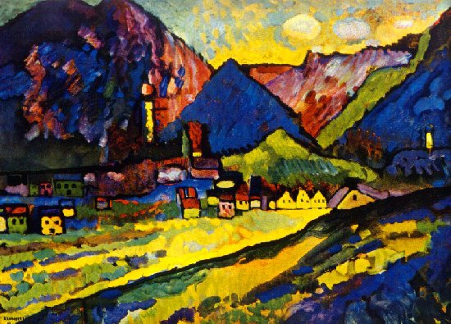

Slide 4
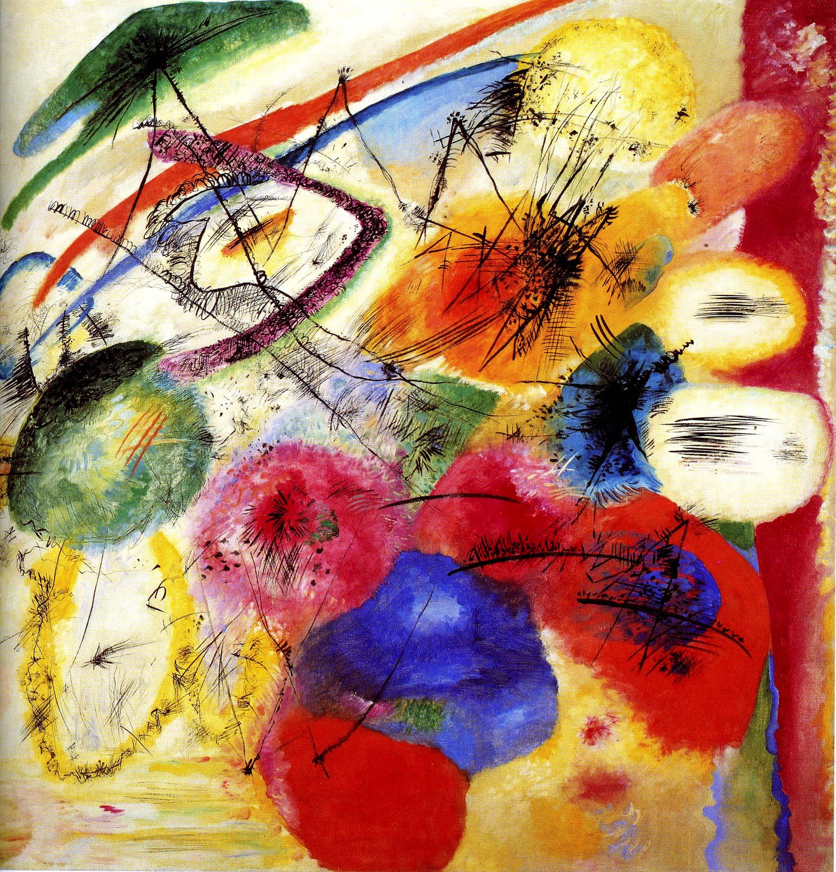

Slide 5
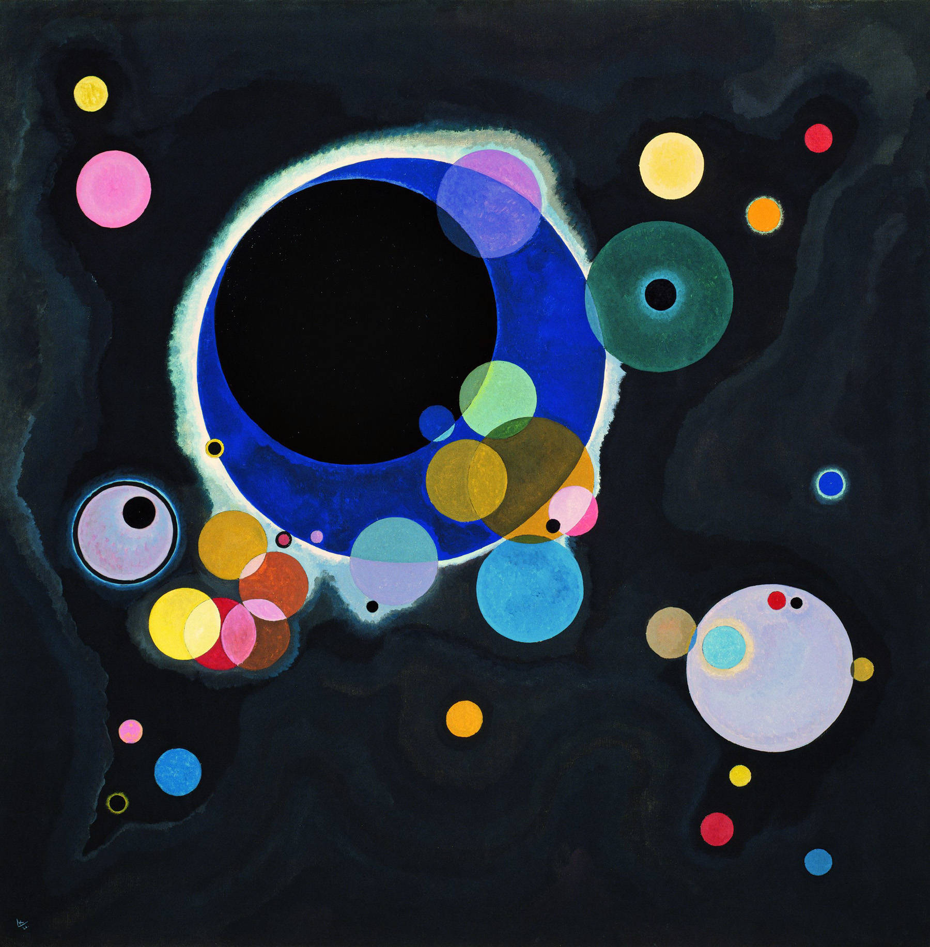

Slide 6
The layman especially should not approach a work with the question “what did the artist not do?” or else ask “How does the artist dare neglect my wishes?” Rather he should ask: “What did the artist do?” or “Which of his inner wishes does the artist express here?”
“On the Question of Form,” The Blue Reiter Almanac, p. 180

Slide 7
“The guardian of the true tradition in art” is the academy of fine art: “to give certain rules to our art and render it pure.” The first rule and absolute standard of fine art, and painting, which is the highest and freest art, is the purity of it. The more uses, relations and “additions” a painting has, the less pure it is. The more stuff in it, the busier the work of art, the worse it is. “more is less.”
Ad Reinhardt

Slide 8
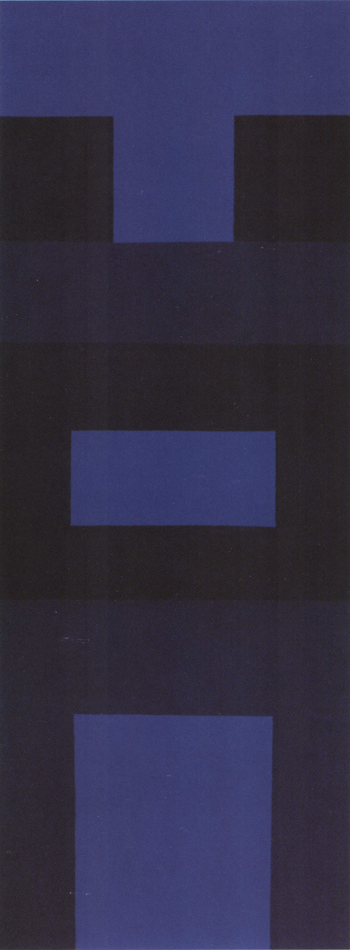

Slide 9
The Twelve Technical Rules (or How To Achieve the Twelve Things to Avoid) to be followed are:
1. No texture ……………No accidents or automatism.
2. No brushwork or calligraphy.
3. No sketching or drawing ……. No shading or streaking.
4. No forms.
5. No design. “Design is everywhere.”
6. No colors….. No white. …….White is antiseptic and not artistic, appropriate and pleasing for kitchen fixtures, and hardly the medium for expressing truth and beauty.”
7. No light.
8. No space. Space should be empty, should not project, and should not be flat.
9. No. time
10. No size or scale.
11. No movement …. “Everything else is on the move. Art should be still.”
12. No object, no subject, no matter ……..No chess-playing.
From: “Twelve Rules for a New Academy (1953) pp. 86- 90. In: A Sourcebook of Artists’ Writings ed. Stiles and Selz.

Slide 10


Slide 11
“Smith has described himself as being “a hundred artists deep,” again alluding to the many forms and styles that have shaped his art-making. “Picasso said that good artists borrow and great artists steal, he says. “Well I am not a great artist, but I do steal.” Yet where Smith construes theft, critics and curators see an ability to synthesize a multitude of influences into a visual lexicon that is distinctly his. With equal self-deprecation, he deplores the way his art has swung back and forth between abstraction and representation, through painterly chance and formal control, unfettered brushwork and powerful connection to the West Coast landscape.
Robin Laurence: “The Grand Synthesizer: Gordon Smith and the Tradition of Painting.” Bordercrossings, 33/3, 2014, pp. 54.

Slide 12
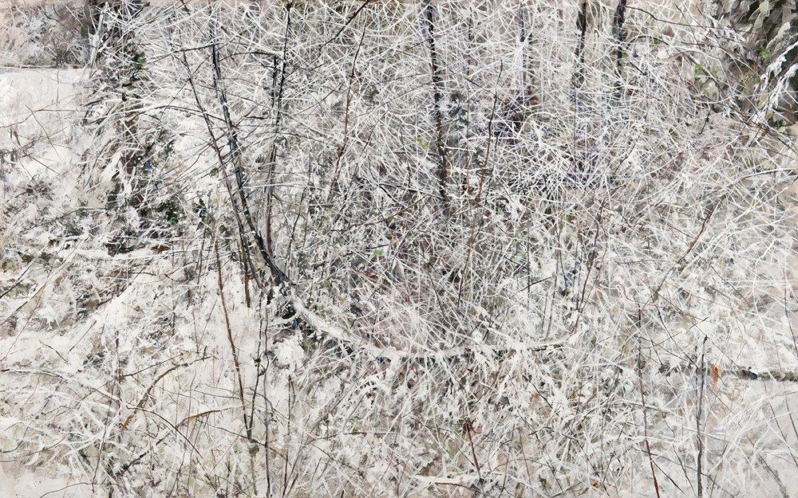

Slide 13
When I draw – a person, an object – I have to make myself aware of proportion, accuracy, abstraction or distortion and so forth. When I paint from a photograph, conscious thinking is eliminated. I don’t know what I am doing. My work is far closer to the Informel than to any kind of ‘realism’. The photograph has an abstraction of it’s own, which is not easy to see through.
It’s what everyone believes in nowadays: it’s ‘normal’. And if that then becomes ‘other’, the effect is far stronger than any distortion, of the sort you find in Dali’s figures or Bacon’s. Such a picture can really scare you.
The photograph took the place of all those paintings, drawings and illustrations that served to provide information about the reality that they represented. A photograph does this more reliably and more credibly than any painting. It is the only picture that tells the absolute truth, because it sees ‘objectively’. It usually gets believed, even where it is technically faulty and the content is barely identifiable. At the same time, photography took on a religious function. Everyone has produced his own ‘devotional pictures’: these are the likeness of family and friends, preserved in remembrance of them.
Photography altered ways of seeing and thinking. Photographs were regarded as true, paintings as artificial. The painted picture was no longer credible; its representation froze into immobility, because it was not authentic but invented.
Life communicates itself through convention and through the parlour games and laws of social life. Photographs are ephemeral images of this communication – as are the pictures that I paint from photographs. Being painted, they no longer tell a specific situation, and the representation becomes absurd. As a painting, it changes both its meaning and its information content.
The photograph is the most perfect picture. It does not change; it is absolute and therefore autonomous, unconditional, devoid of style. Both in its ways of informing, and in what it informs of, it is my source.
A photograph is taken to inform. What matters to the photographer and to the viewer is the result, the legible information, the fact captured in an image. Alternatively, the photograph can be regarded as a picture, in which case the information conveyed changes radically. However, because it is very hard to turn a photograph into a picture simply by declaring it to be one, I have to make a painted copy.
Gerhard Richter, from “The Daily Practice of Painting”

Slide 14
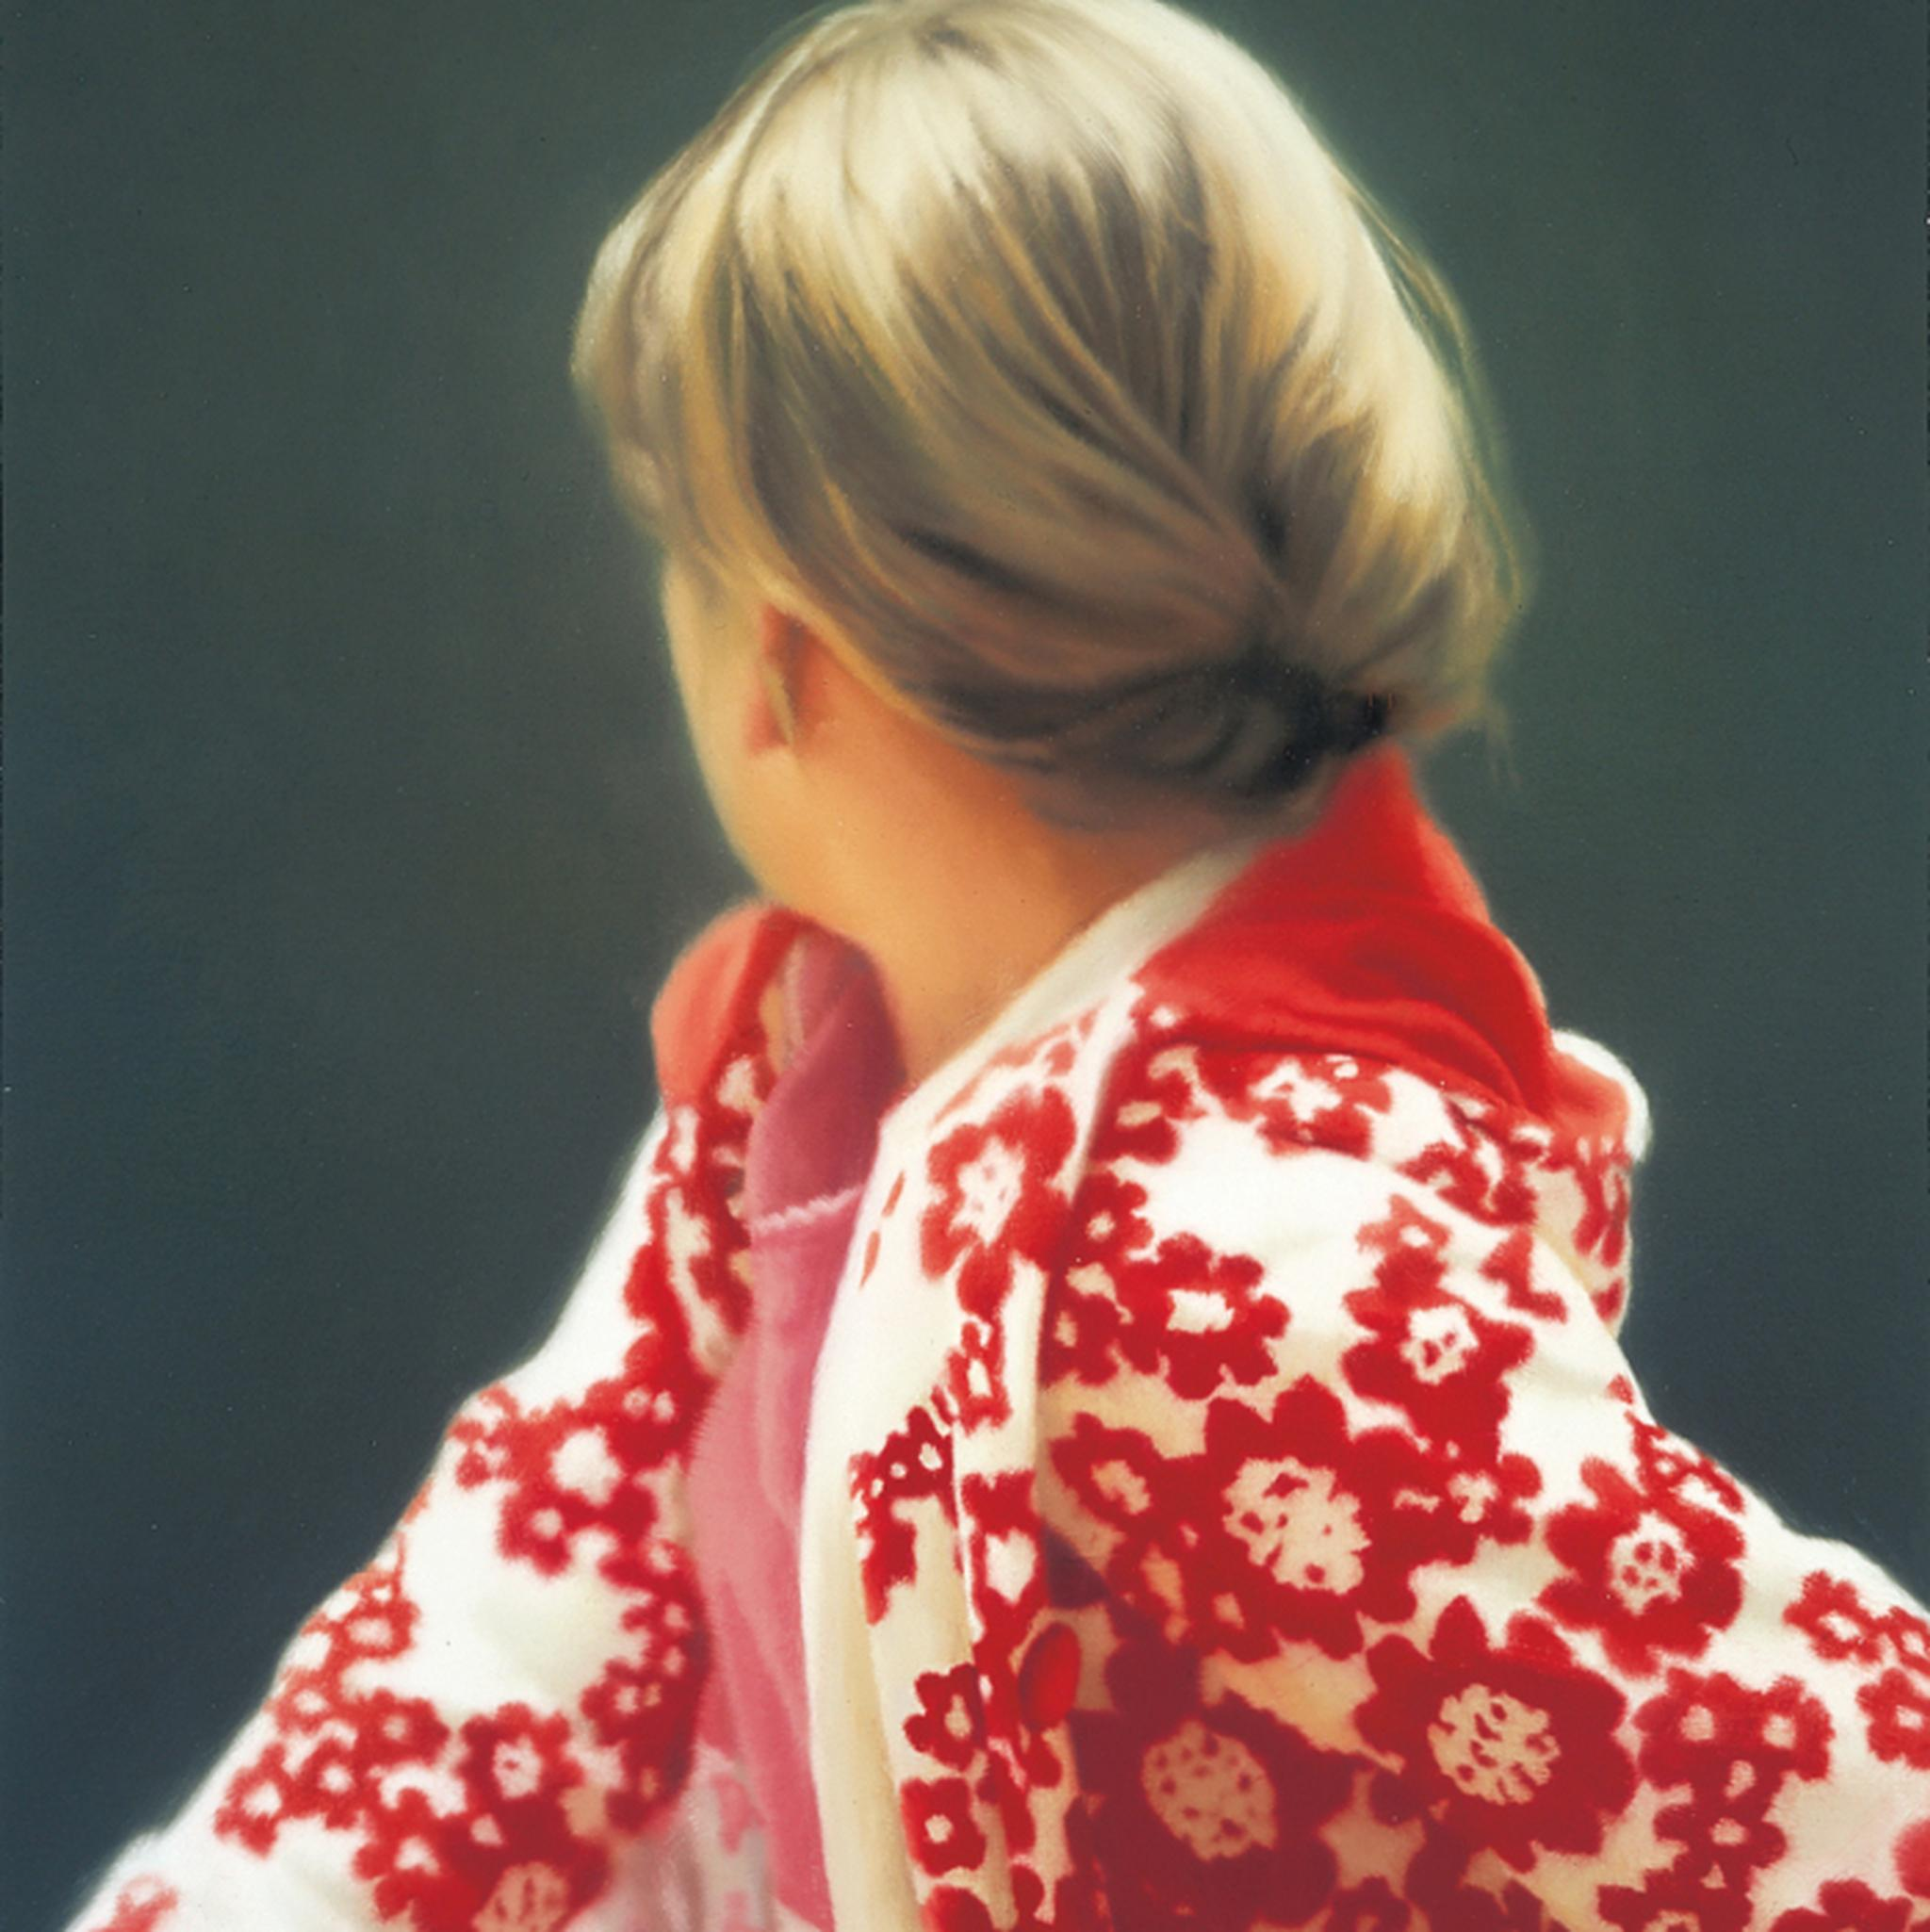

Slide 15
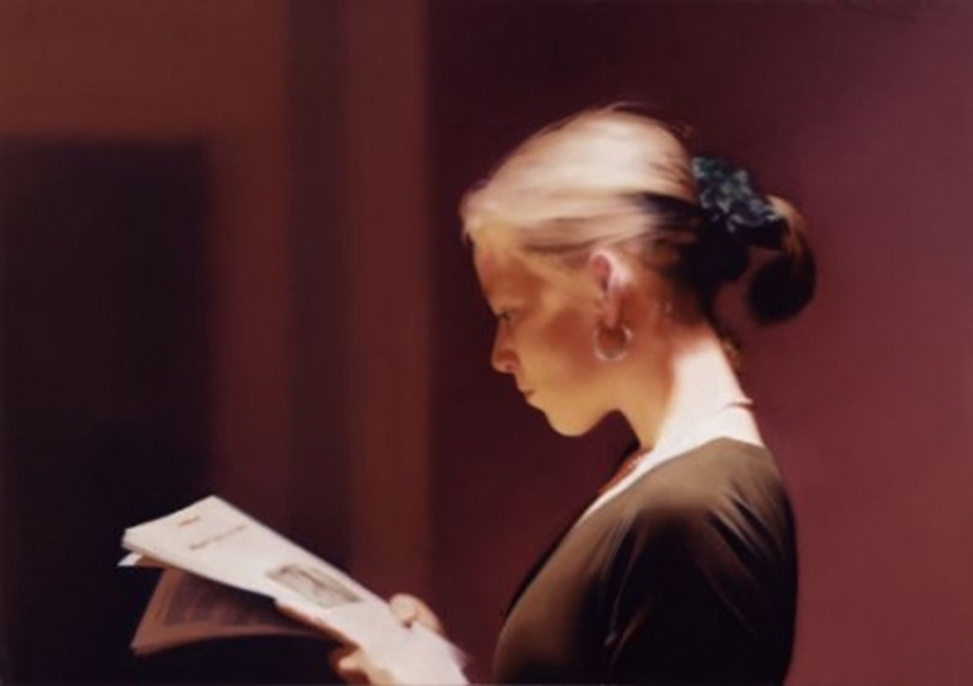

Slide 16
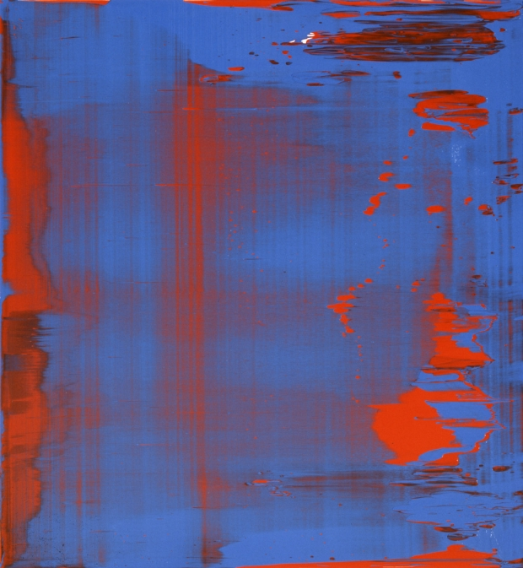

Slide 17
“…..I never started a painting with a vision of what it would ultimately look like or a definite idea of what it was about. Every painting I make is a journey for me and how I begin is never the same. I start with fragments – the gesture of a person that intrigues me or something mundane as a bowl of fruit or a sleeping dog – and then I free-associate, respond to the image I put on the canvas, listen as the painting begins to talk to me. Every painting of mine is a search for meaning. Every painting I finish is the discovery of meaning.”
- Eric Fischl

Slide 18
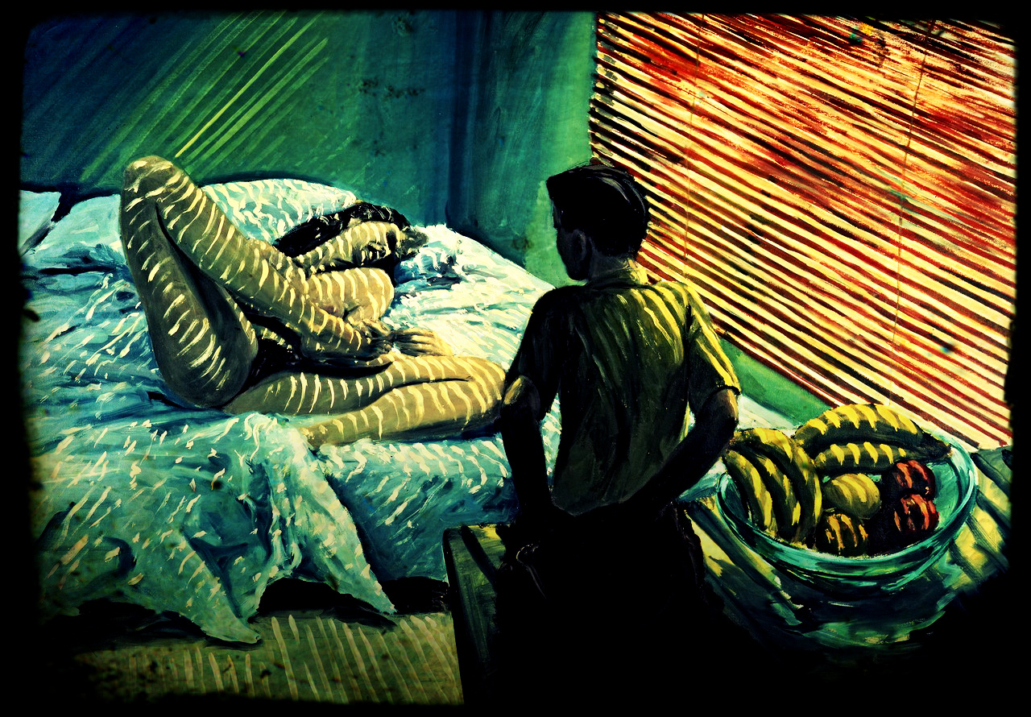

Slide 19
Early on in my life I wanted to embrace the margins, but as I grew up I came to realize that much of my life has been a search for normal. I have consciously tried to make work that took fragments and pieced them back together – impressions and bits of memory collaged into foreign lands or suburban settings, all with the purpose of making them appear seamless. I was reliving my experiences as I was painting them, always at the point just before things fall apart.
-Eric Fischl

Slide 20
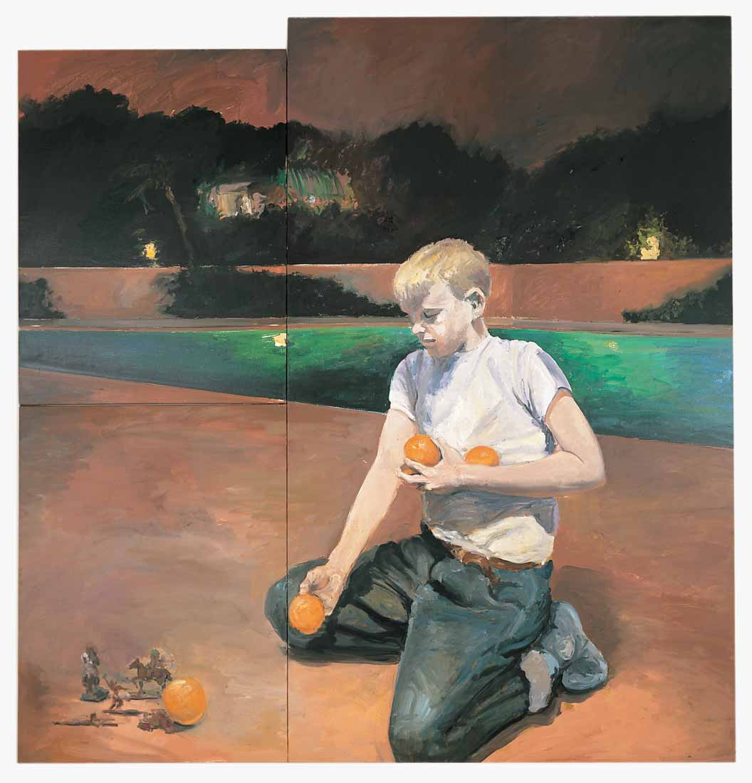

Slide 21
I was uncomfortable with fragmentation and meaninglessness even though I appreciated it in other people’s work. I needed the world around me to make sense, though not in a stultifying or overdetermined way. Rather, I felt an obligation to give my audience the impression of a coherent moment that was emotionally charged and fragile but still holding together long enough so viewers could reflect on what it meant. Except in the case of multi-panel paintings, I did not want to make my audience put something back together in order to understand what it means.
Eric Fischl, Bad Boy, pp. 119, 214-215.

Slide 22
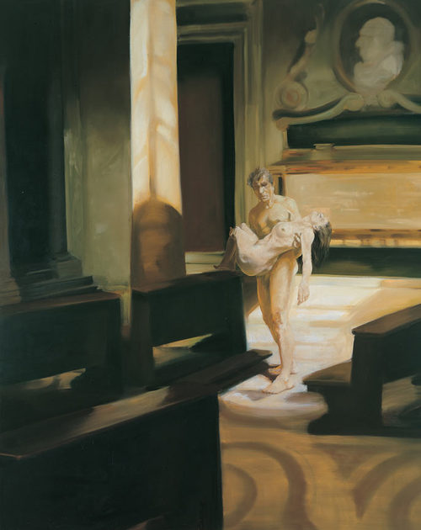

Slide 23
When I actually can sit there and not get bored, or not get the desire to do something else to it, or not have the impulse to turn it to the wall. When it is something I look at and say. “Wow, I could never have done that.” The in the fun of looking at it, the desire comes back.
………..
Even though I work towards a solution, that solution is not what makes the painting. What makes the painting is what you were saying: that it demands attention but it is never to the whole painting. The attention will always be to a detail, a part, an atmosphere or a relation you create as a viewer.
“Two Little and Too Much –All The Time: Charline Von Heyl and the Life of Painting. Interview by Robert Enright and Meeka Walsh Bordercrossings, 33/3, 2014, pp. 49-50.

Slide 24
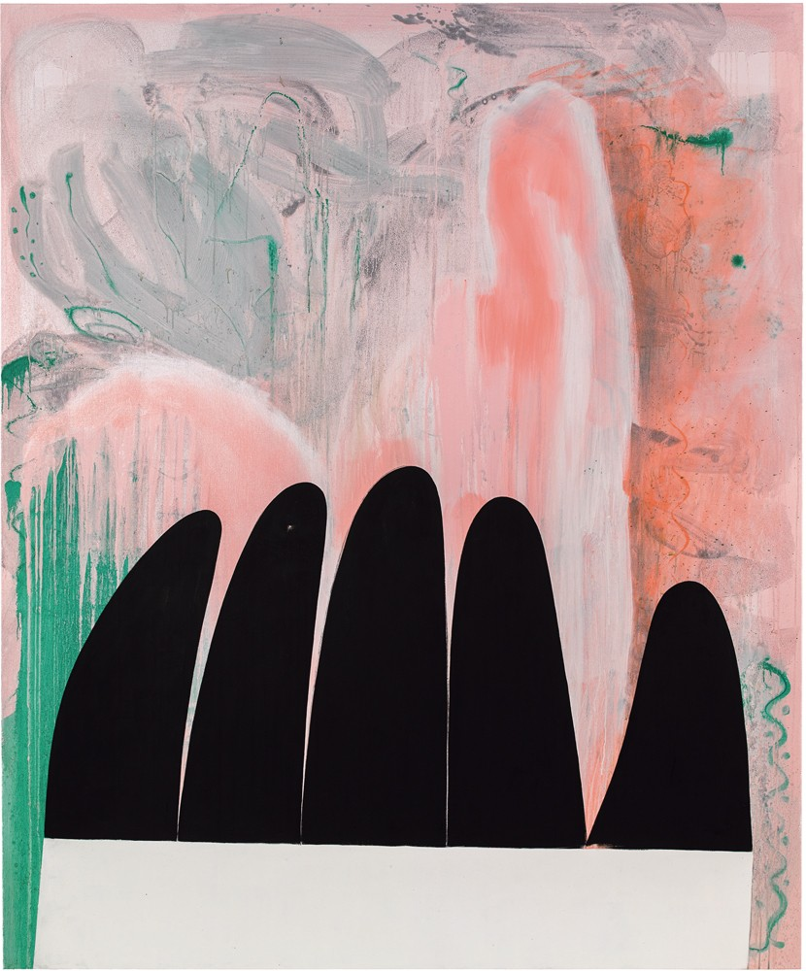

Slide 25
